Slide 1
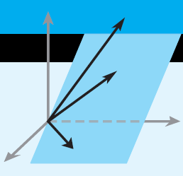
Elementary Linear Algebra
Howard Anton Copyright © 2010 by John Wiley & Sons, Inc.
All rights reserved.
Chapter 8
Notes:
*

Slide 2
Chapter 8 Linear Transformations
8.1 General Linear Transformations
8.2 Isomorphisms
8.3 Compositions and Inverse
Transformations
8.4 Matrices for General Linear
Transformations
Notes:
*

Slide 3
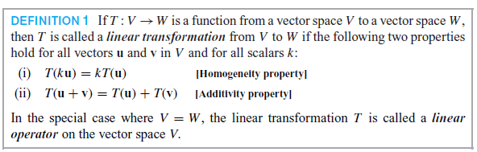
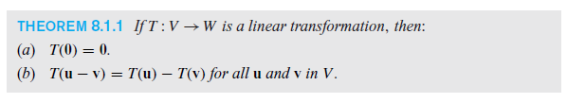
General Linear Transformations
Notes:
*

Slide 4
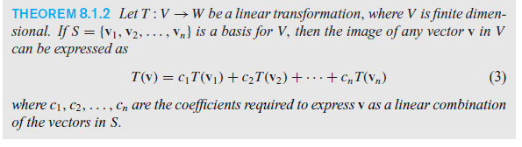

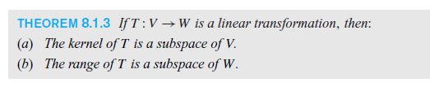
Image, Kernel and Range
Notes:
*

Slide 5
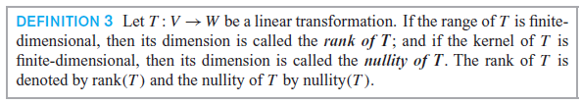
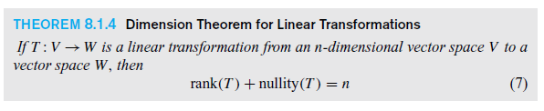
Rank, Nullity and Dimension
Notes:
*

Slide 6
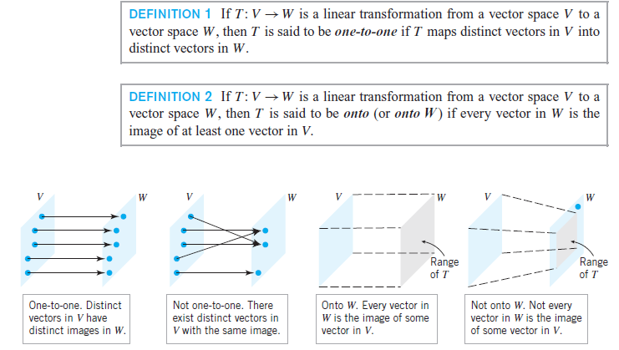
Isomorphism
Notes:
*

Slide 7
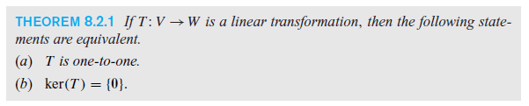
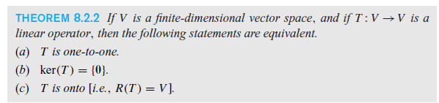

Isomorphism
Notes:
*

Slide 8
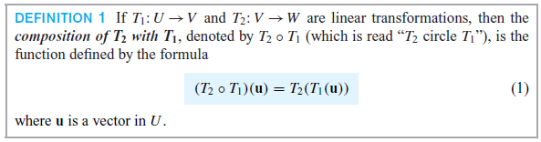
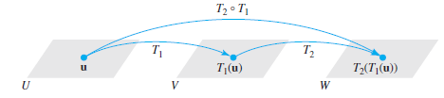
Compositions and Inverse Transformations
Notes:
*

Slide 9
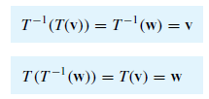

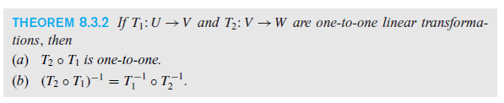
Inverses
Notes:
*

Slide 10
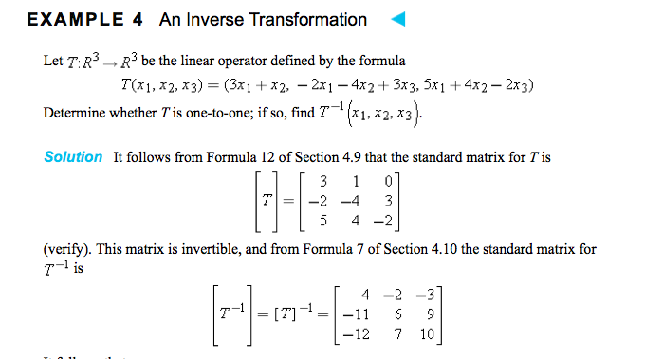



Slide 11
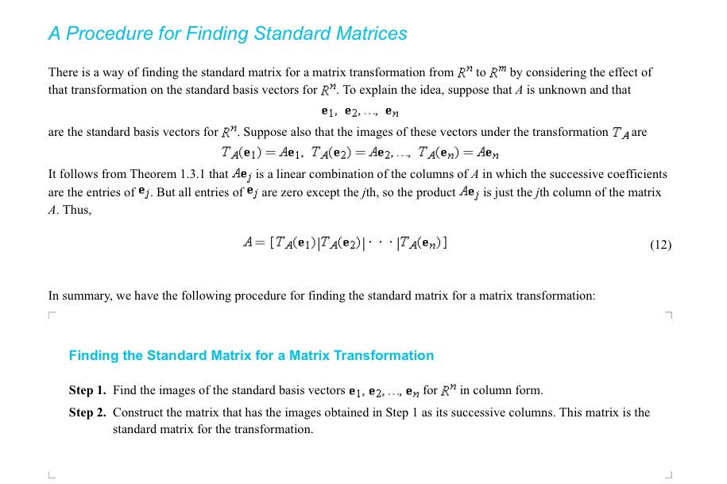

Slide 12
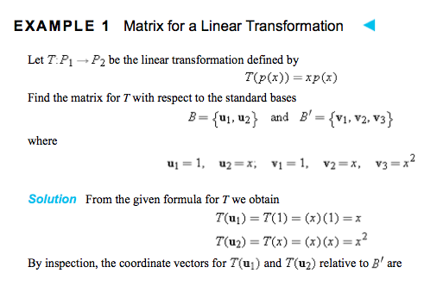
Matrices for General Linear Transformations
Notes:
*

Slide 13
